Slide 1
Explore two variables
Section overview
● Scatter plot
● Smoothing line and transformed axis
● Rug plot
● Continuous bivariate distribution
● Boxplot
● Violin plot
● Comparing two discrete variables
● Matrix plots

Slide 2
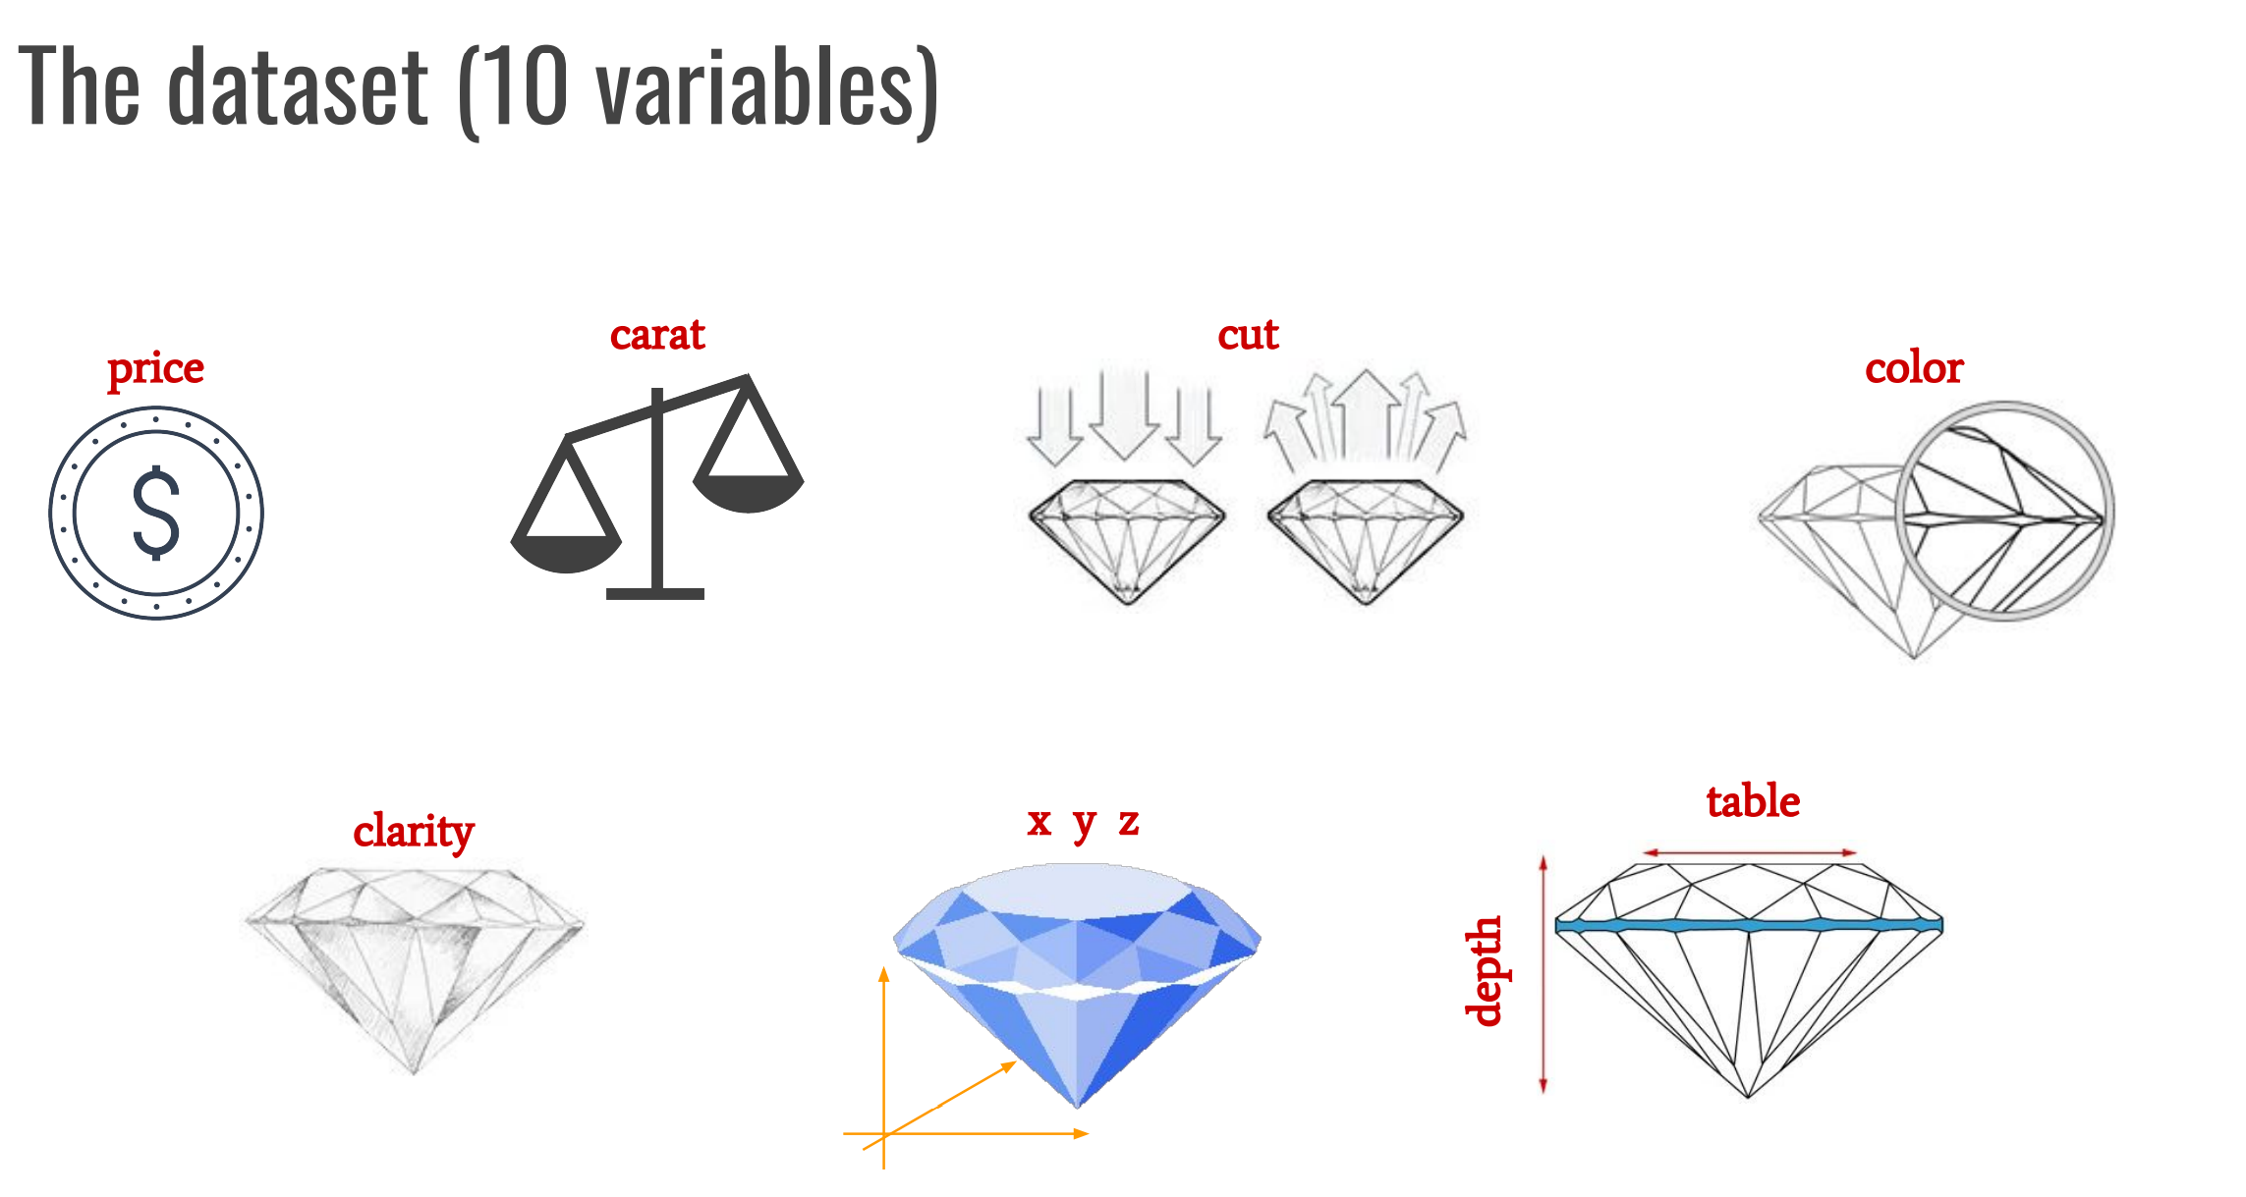
Diamonds dataset
price in US dollars
weight of the diamond
quality of the cut
diamond colour
a measurement of how
clear the diamond is
X length in mm
Y width in mm
Z depth in mm
total depth percentage = z / mean(x, y)
= 2 * z / (x + y)
R SCRIPT

Slide 3
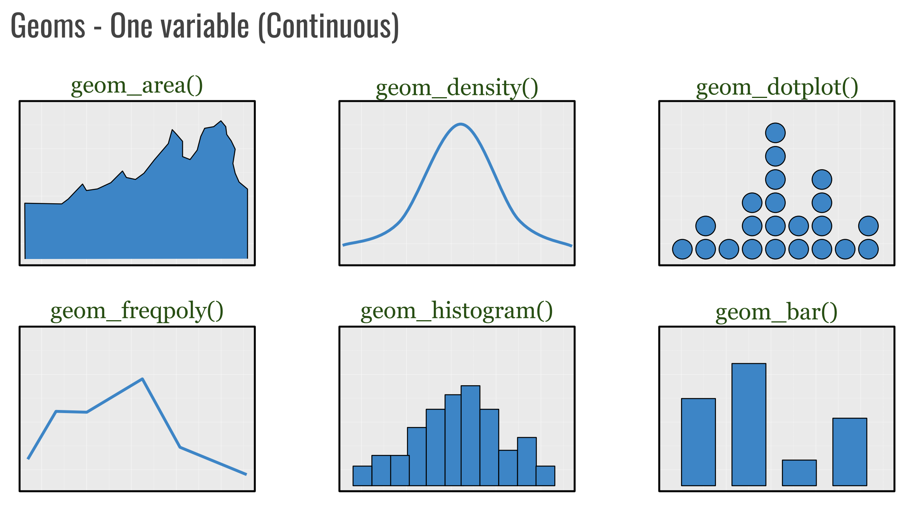

Slide 4
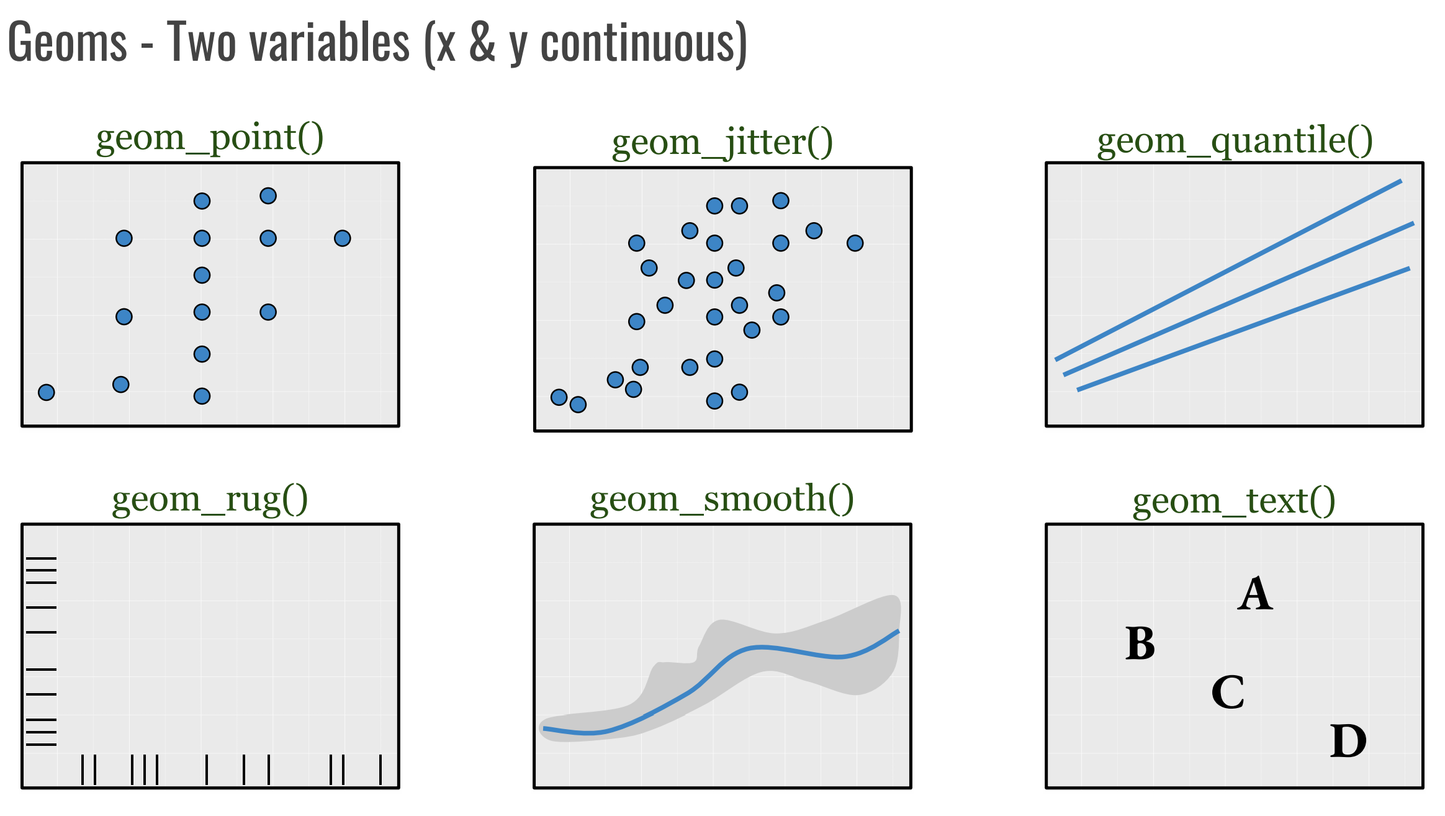
Scatterplots

Slide 5
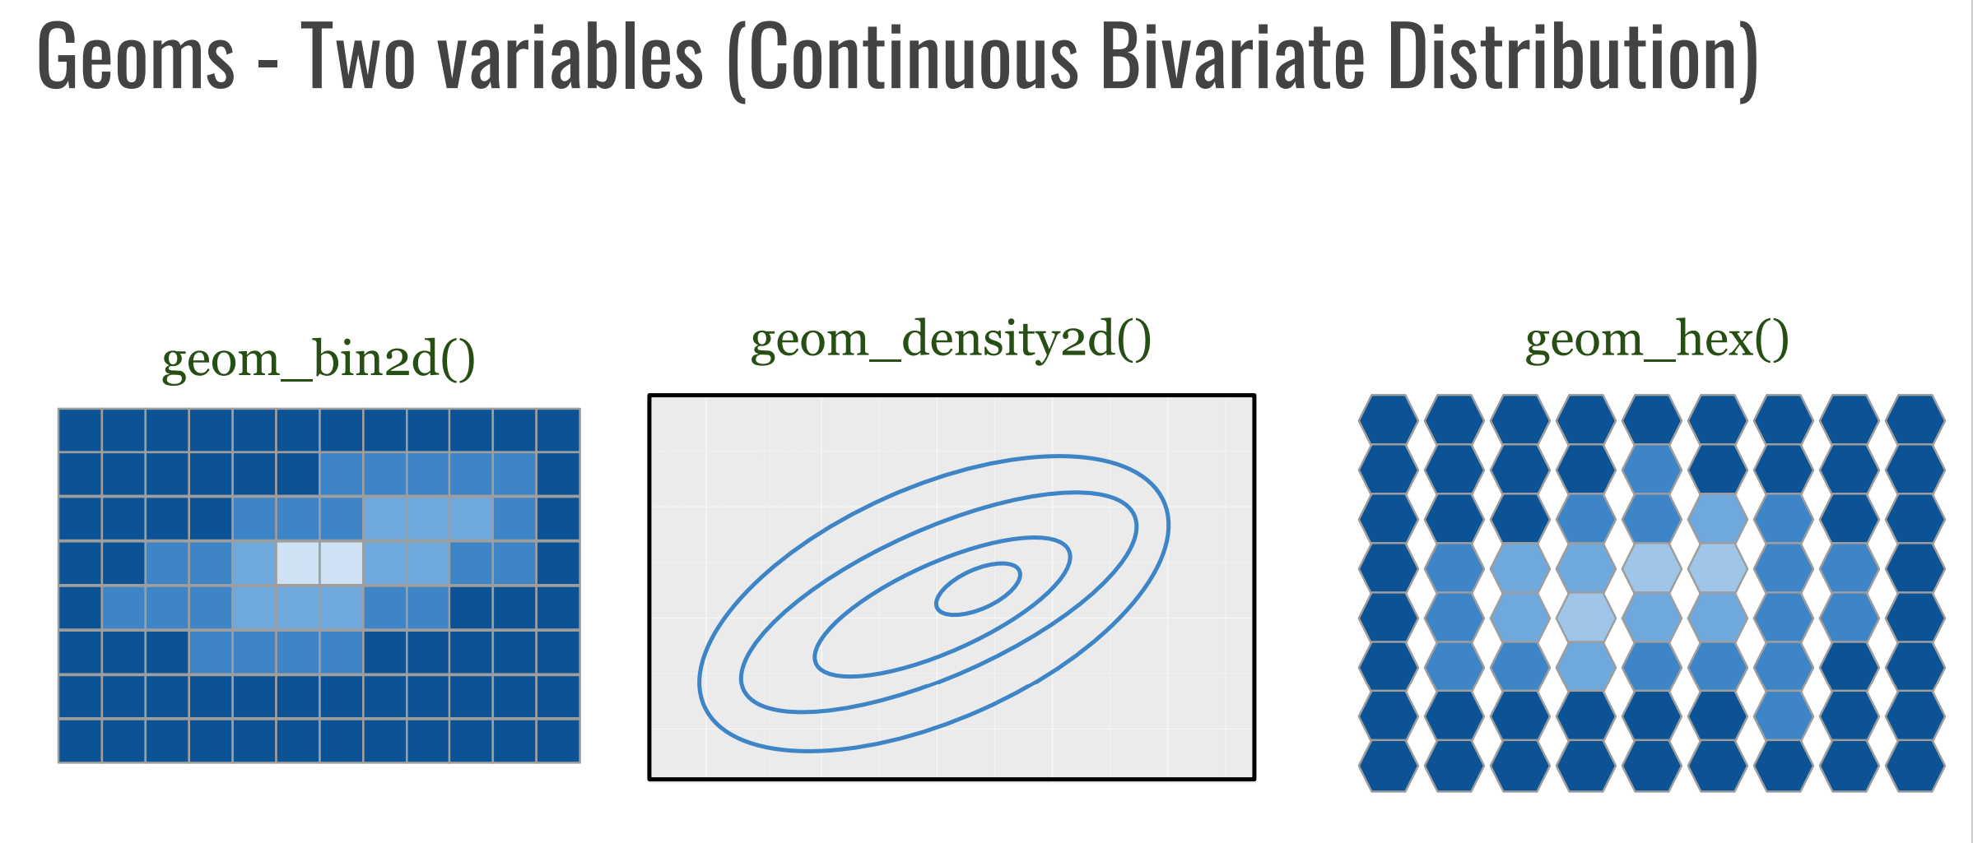

Slide 6
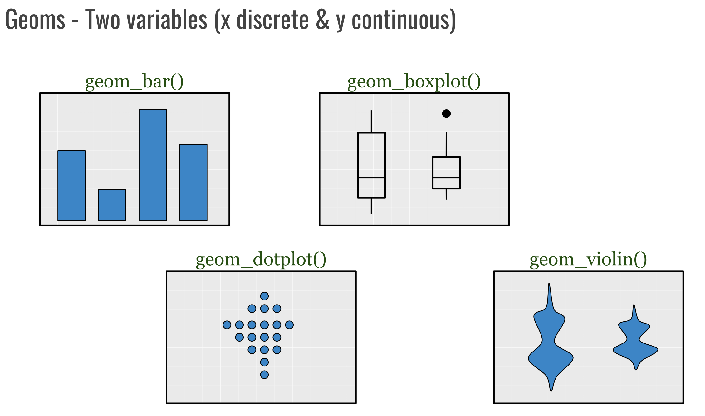

Slide 7
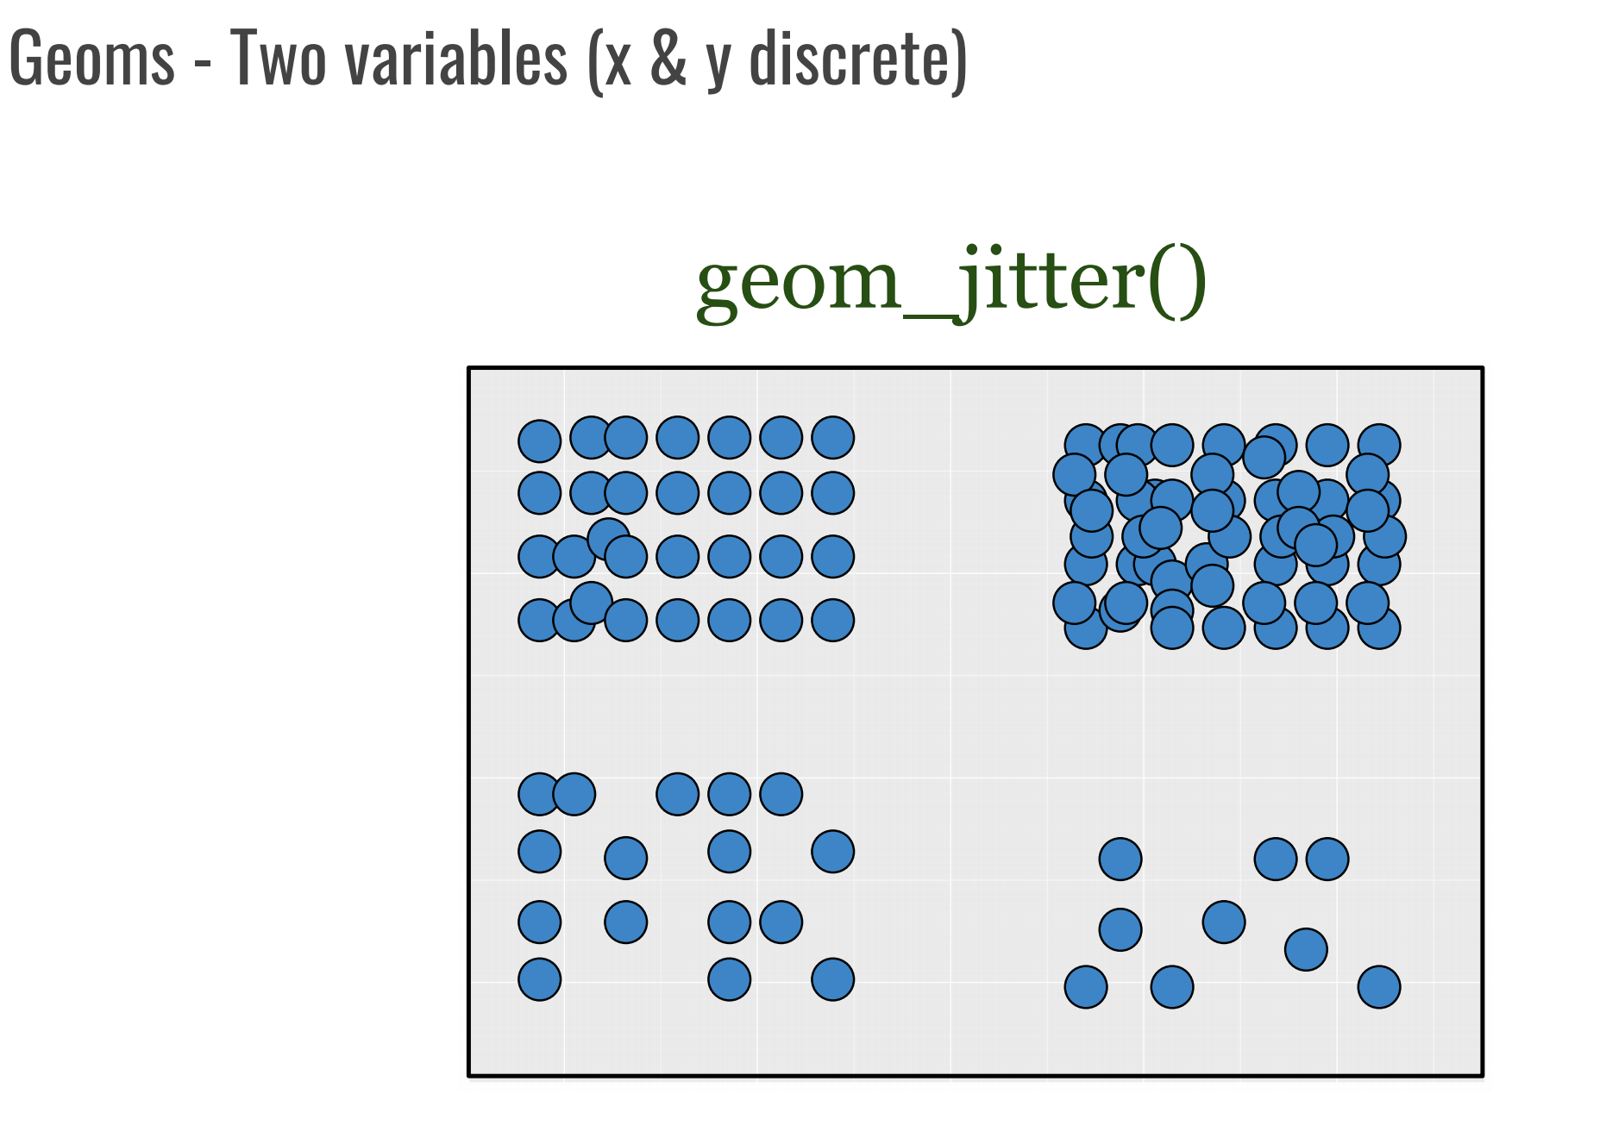

Slide 8
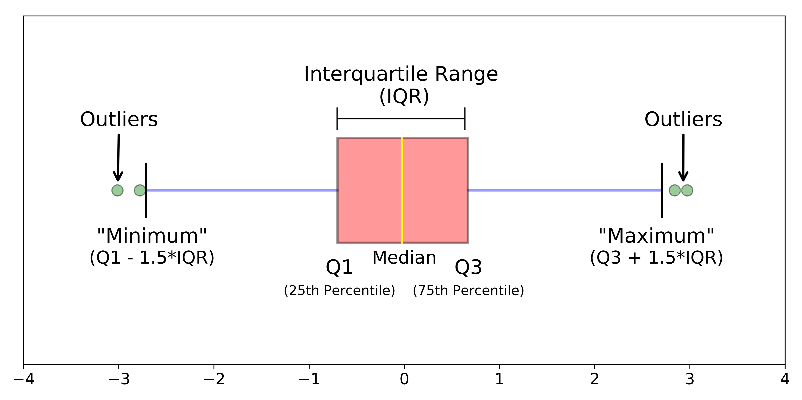
Box plot

Slide 9
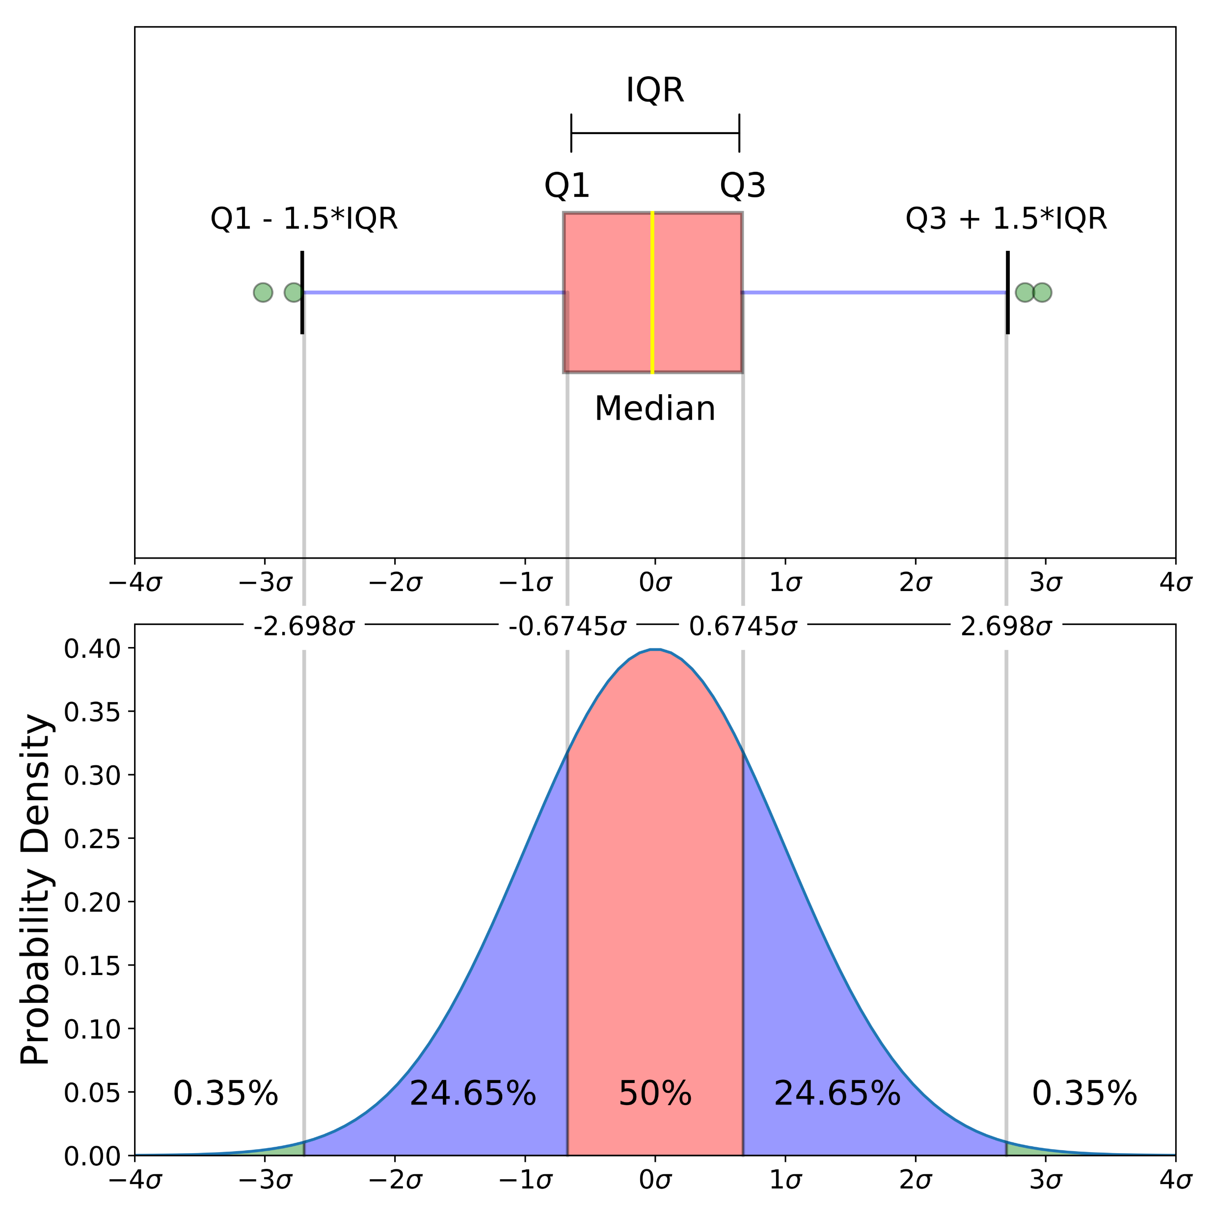
Box plot of a normal distribution
If a box plot has equal proportions around the median,
we can say distribution is symmetric or normal.
7% of the data are outliers

Slide 10
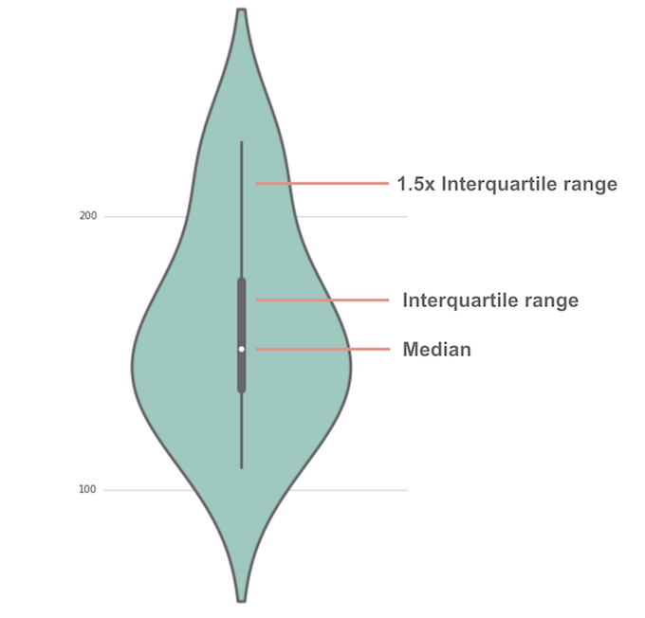
The anatomy of a violin plot
Violin plots have many of the same summary statistics as box plots:
the white dot represents the median
the thick gray bar in the center represents the interquartile range
the thin gray line represents the rest of the distribution, except for points that are determined to be “outliers” using a method that is a function of the interquartile range.

Slide 11
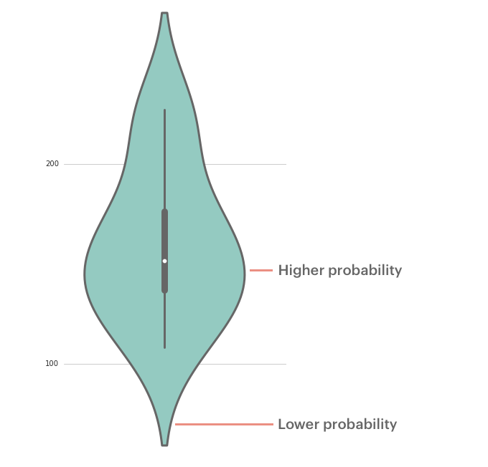
The anatomy of the violin plot

